Slide 2
Base Algorithm
Calculate Body Statistics
Display Classification and Statistical Output
Compile Skeletal Data
Classification
Input from Kinect Depth Camera
Motion Energy Database
Add sample to database
Future Possible Improvements
Current Implementation

Slide 3
Classification Algorithm
Input Image
Score Image
Select Smallest E-Distance
Calculate Euclidian Distance
No remaining images
Score Image
Sum E-Distance
Database Images
Score remaining images

Slide 4
Statistical Methods
Statistical Analysis | Method
Stride Length Relative to Average | Analyze x-axis difference between right and left foot.
Arm Swing Relative to Average | Analyze x-axis difference between right and left elbow.
Relative Knee Movement | Compute the y-axis difference of maximum and minimum knee height.

Slide 5
Experimental Analysis
Stride Relativity (%) 100* (stride_max/stride_avg) | Correlation
100 – 185 | Slow Walk/Shuffle
205 – 400 | Normal Walk
401 – 550 | Long Step
600 - 800 | Exaggerated Step
Knee Movement (%) 100*((knee_max – knee_min) / knee_max) | Correlation
1 - 6 | Slow Walk/Shuffle
7 – 9 | Normal Walk
9 - 15 | High Knee Exercise

Slide 6
Walking Classification Accuracy
Walking Classification | Identification Accuracy
Walking | 70%
Exaggerated Stride | 40%
Wounded Leg | 60%
Timed Get-Up-and-Go | 85%
Fast Walk | 75%
Slow Walk | 50%
Arthritis Prone | 40%

Slide 7
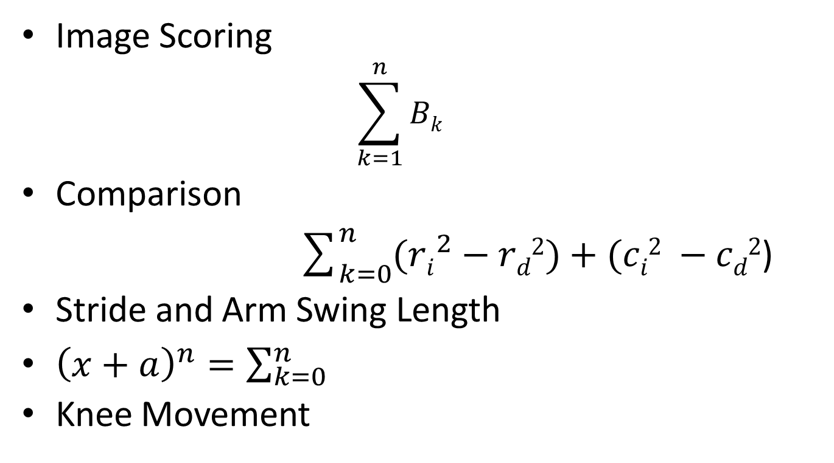
Mathematical Articulation
Image Scoring
$$\sum_{k=1}^{n}{Bk}$$
Comparison
$\sum_{k=0}^{n}{({ri}^{2}−rd2)+(ci2 −cd2}$)
Stride and Arm Swing Length
${\left(x+a\right)}^{n}=\sum_{k=0}^{n}{}$
Knee Movement

Slide 8
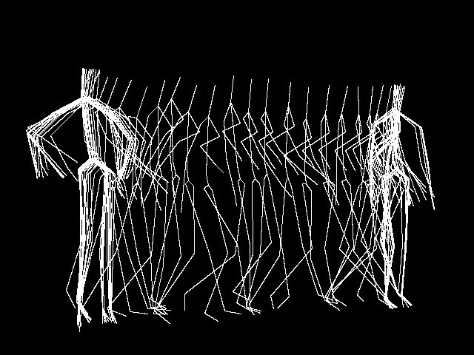
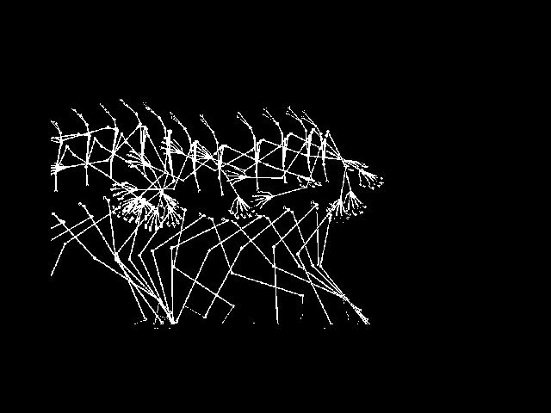
Kinect Image
Column Score Sequence:
0 35 140 85 79 65 30 45 40 50 75 140 0
Database Image
Column Score Sequence:
0 35 45 50 45 40 30 45 40 30 0 0 0 0 0

